Slide 1
SALARY AND COMPENSATION ANALYSIS THOUGH EXCEL DATA MODELING
STUDENT NAME: B.SANTHOSH
REGISTER NO: 312214543/57D200435520C1CB65A4165CB4AC9111
DEPARTMENT: BCOM CA
COLLEGE: ST THOMAS COLLEGE OF ARTS AND SCIENCE

Slide 2
PROJECT TITLE
SALARY AND COMPENSATION ANALYSIS THOUGH EXCEL DATA MODELING

Slide 3


AGENDA
Problem Statement
Project Overview
End Users
Our Solution and Proposition
Dataset Description
Modelling Approach
Results and Discussion
Conclusion
3/21/2024 Annual Review

Slide 4

PROBLEM STATEMENT
Problem Statement: Analyze salary and compensation data to identify trends, disparities, and areas for improvement.

Slide 5

PROJECT OVERVIEW
.
.
Collect and clean salary and compensation data for all employees- Develop a data model in Excel to analyze and visualize the data- Conduct statistical analysis and data visualization to identify trends and disparities- Develop recommendations for optimizing salary and compensation structures

Slide 6

WHO ARE THE END USERS?
1.HR Professionals
2.Business Leaders
3.Compensation Committees
4.Recruiters
5.Finance Teams
6.Operations Managers
7.Union Representatives
8.Researchers
9.Consultants

Slide 7

OUR SOLUTION AND ITS VALUE PROPOSITION
Solution Overview
1.Comprehensive data model for salary and compensation analysis
2. Automated data cleaning and preprocessing
3.Advanced statistical analysis and visualization
4.Customizable dashboards for easy reporting and analysis
Value Proposition
1.Identify trends and disparities in salary and compensation
2.Optimize salary and compensation structures
3.Improve transparency and visibility

Slide 8
Dataset Description
Kaagle-employee dataset
26 feature
9 features
Emp id- numerical
Fn- text
Ln- text
Business unit- text
Gender-male, female
Performance score- text
Rating- numerical (5,4,3,2)

Slide 9

THE "WOW" IN OUR SOLUTION
*=IFS(28>=5,"VERY HIGH",28>=4,"HIGH" 28>=3,"MED", TRUE, "LOW")
3/21/2024 Annual Review
9

Slide 10
MODELLING
Data Collection
Gather Relevant Data:
Employee Data: Names, job titles, departments, levels, locations, etc.
Compensation Data: Base salary, bonuses, stock options, benefits, etc.
Benchmark Data: Industry salary data, geographic salary differentials,
2. Data Organization:
Create a Clean Data Structure:
sheets:Organize data into different sheets if necessary (e.g., Employee Data, Compensation Data, Benchmark Data).
Tables: Use Excel Tables (Insert > Table) to structure data, which makes it easier to manipulate and analyze.
10

Slide 11
RESULTS
11

Slide 12
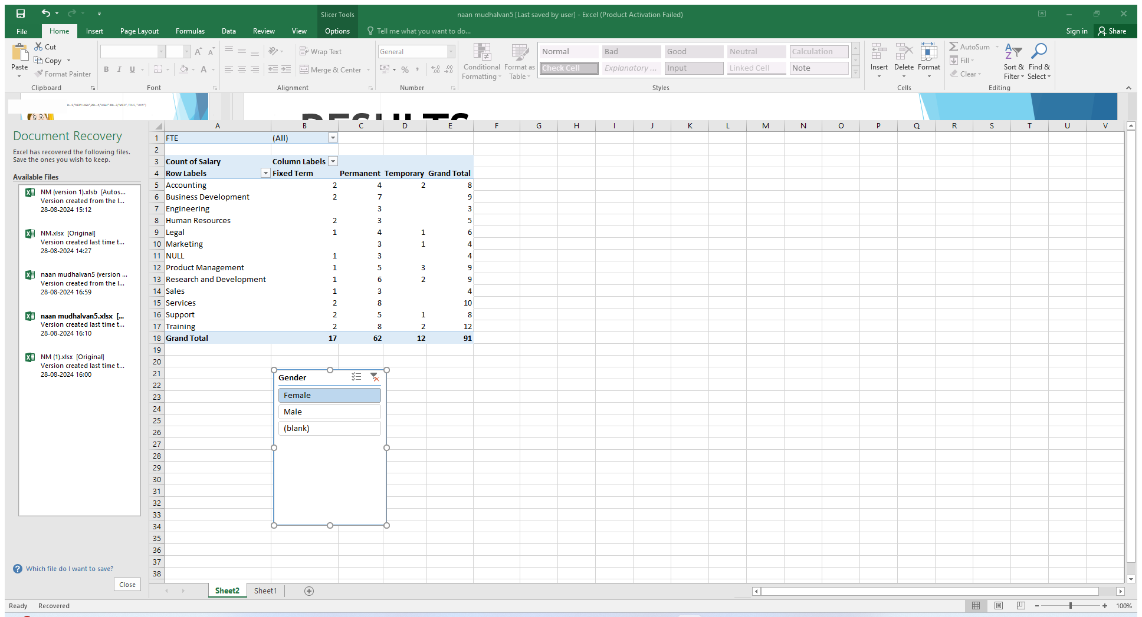
RESULTS
12

Slide 13
conclusion
In conclusion, the salary and compensation analysis through Excel data modeling provides a comprehensive understanding of compensation structures and trends within an organization. By leveraging Excel's powerful data analysis tools, we can identify key patterns and insights, such as salary distribution, compensation disparities, and the impact of various factors like experience, education, and job role on overall pay. This analysis not only helps in making informed decisions regarding pay equity and competitive compensation strategies but also aids in budgeting and forecasting future compensation needs. Ultimately, using Excel for this purpose enables organizations to align their compensation practices with industry standards, improve employee satisfaction, and support strategic HR planning.

